Slide 1

NAME: E.G.PRADEEP ROLL NO : RA2211004050026 DEP: B.TECH.ECE SUB: DESIGN THINKING METHODOLOGY SUB CODE : 21DCS201P

Slide 2
EMPATHY: 1.Empathy is the ability to understand and share the feelings, emotions, and perspectives of others. It involves putting oneself in someone else's shoes, seeing the world from their point of view, and feeling what they are feeling. 2.Empathy goes beyond sympathy, which is merely acknowledging and feeling sorry for someone's pain or difficulties. EMPATHY MAPPING CANVAS : 1.An empathy mapping canvas is a visual tool used to understand and document the thoughts, feelings, actions, and experiences of a particular user or customer. 2. It typically consists of a simple framework divided into sections representing different aspects of the user's experience.

Slide 3
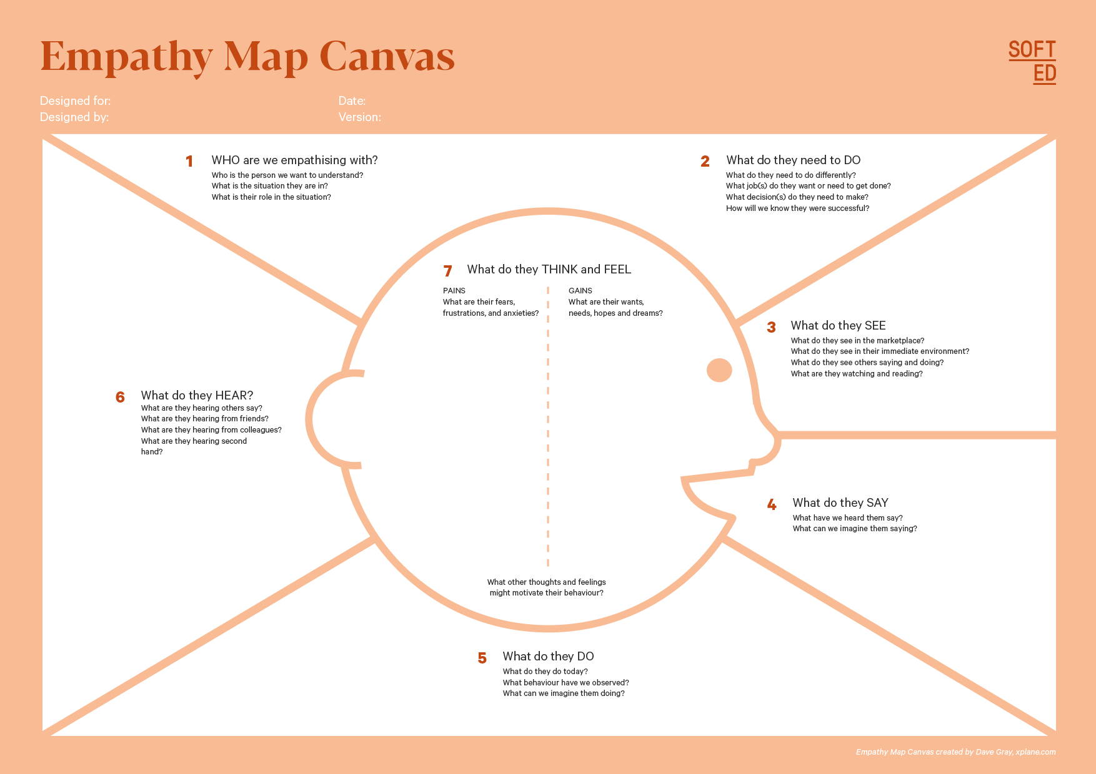
EMPATHY MAPPING CANVAS EXAMPLE :

Slide 4
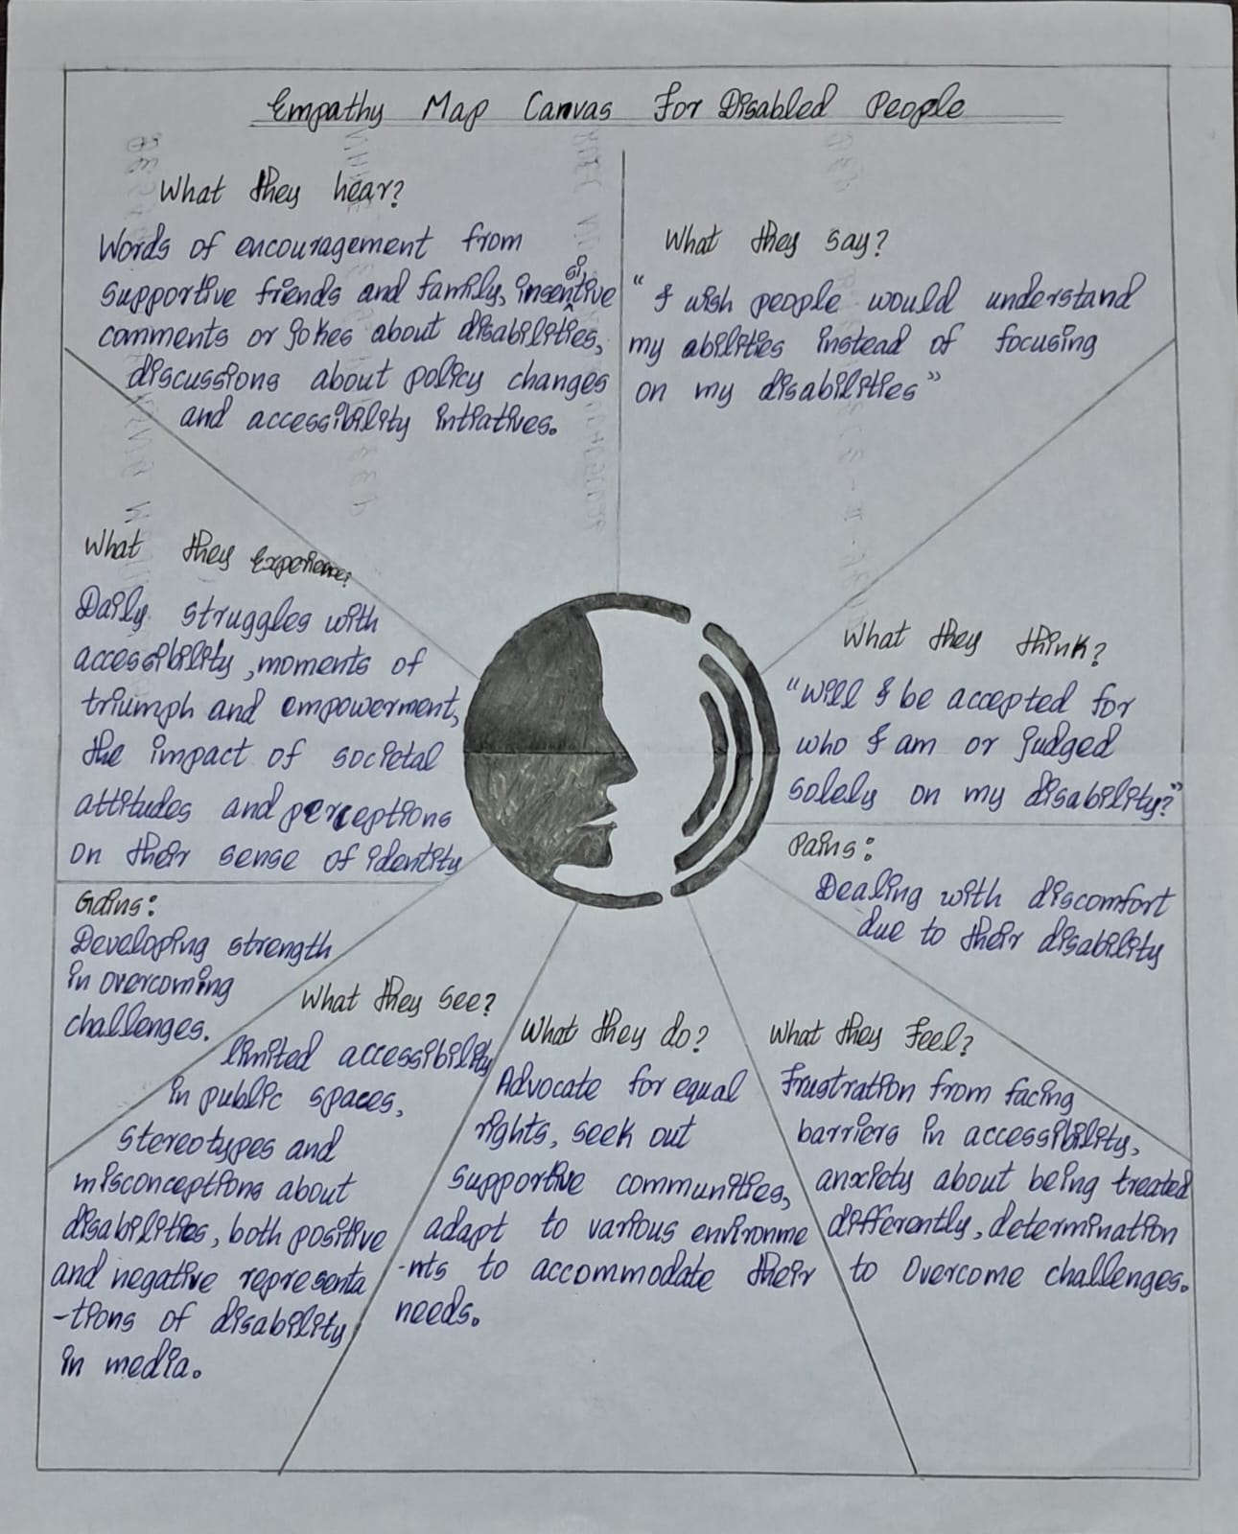
MY ASSIGNMENT :

Slide 5
THANK YOU

